Slide 1
Poetry Elements
alliteration- the repetition of the beginning
consonant sounds in words
ex. Slimy slugs slither slowly on the sidewalk.
imagery- words or phrases that have vivid descriptions that appeal to the five senses. It creates a picture in the reader’s mind
ex. The thick fuzzy coat was a blessing in the winter blizzard.
metaphor- a comparison of two different things. It is like a simile without like or as.
ex. A good laugh is sunshine in a house.
meter- a rhythmic pattern in poetry that is usually repeated. It can be measured in beats by counting syllables.

Slide 2
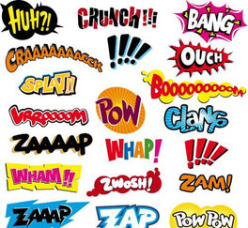
Poetry Elements
mood- the emotion that the reader feels
while they are reading. For many poems, the main
purpose is to set a mood.
onomatopoeia- a sound associated with what is named
ex. bang! ding! pop!
repetition- to repeat sounds, words, phrases, or whole lines in a poem.
ex. Leaving my friends, leaving my home, leaving my room, leaving my memories.

Slide 3
Poetry Elements
rhyme- words that end in the same sound; end rhyme
ex. school, tool, rule
rhyme scheme- The pattern of rhymes. A letter is assigned to each end of the line. If it rhymes with another end of line, it has the same letter.
ex. Roses are red A
Violets are blue B
Sugar is sweet C
And so are you. B
rhythm- the musical quality of a poem using alliteration, meter, repetition, or rhyme

Slide 4
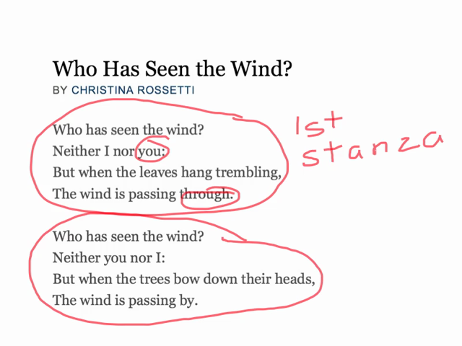
Poetry Elements
simile- a comparison of two unlike things using like or as
ex. She was as pale as sugar.
stanza- a division in a poem named for the number of lines it contains (a poetry paragraph)
theme- the message about life that the poem conveys
tone- the author’s attitude towards the
writing and the audience. Tone is conveyed
through the author’s words and details. There
can be more than one tone

